Slide 1
Support Vector Machines
Dr. Mehmet Yasin Ulukuş

Slide 2
Support Vector Machines
An approach for classification that was developed in the computer science community in the 1990s
SVMs have been shown to perform well in a variety of settings
Generalization of a simple and intuitive classifier called the maximal margin classifier
Maximal margin classifiers cannot be applied to most datasets (linearly inseparable)
We will introduce the support vector machines, an extension of the maximal margin classifier that can be applied in a broader range of cases

Slide 3
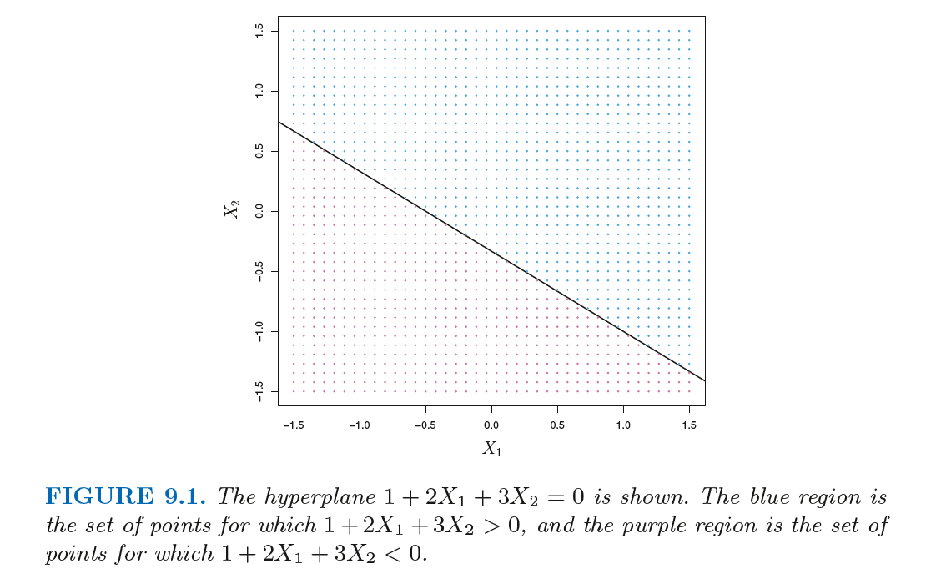
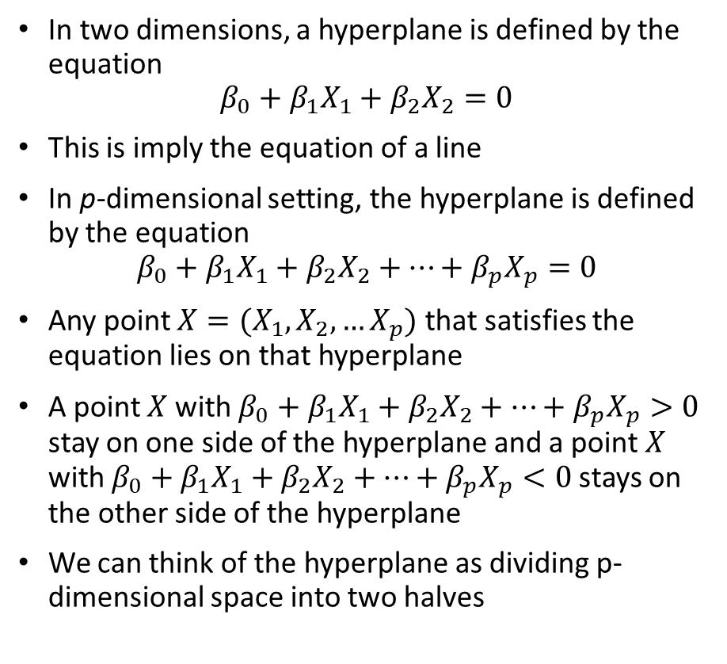
Maximal Margin Classifier
In two dimensions, a hyperplane is defined by the equation
$$β_{0}+β_{1}X_{1}+β_{2}X_{2}=0$$
This is imply the equation of a line
In p-dimensional setting, the hyperplane is defined by the equation
$$β_{0}+β_{1}X_{1}+β_{2}X_{2}+…+β_{p}X_{p}=0$$
Any point $X=(X_{1},X_{2},…X_{p})$ that satisfies the equation lies on that hyperplane
A point $X$ with $β_{0}+β_{1}X_{1}+β_{2}X_{2}+…+β_{p}X_{p}>0$ stay on one side of the hyperplane and a point $X$ with $β_{0}+β_{1}X_{1}+β_{2}X_{2}+…+β_{p}X_{p}<0$stays on the other side of the hyperplane
We can think of the hyperplane as dividing p-dimensional space into two halves

Slide 4
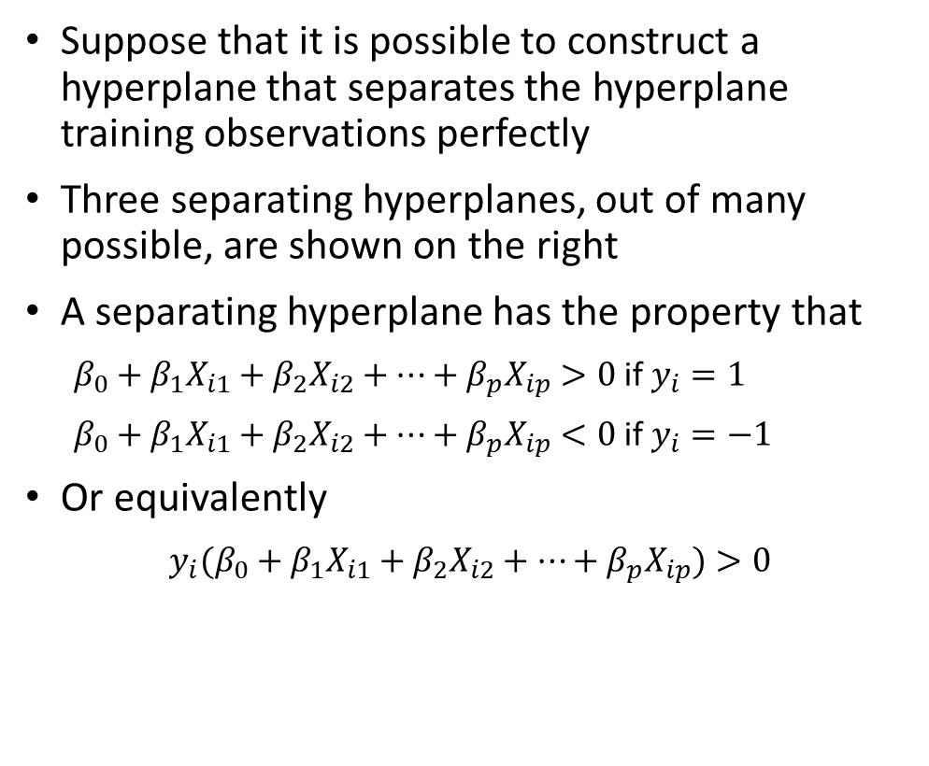


Maximal Margin Classifier
Suppose that it is possible to construct a hyperplane that separates the hyperplane training observations perfectly
Three separating hyperplanes, out of many possible, are shown on the right
A separating hyperplane has the property that
$β_{0}+β_{1}X_{i1}+β_{2}X_{i2}+…+β_{p}X_{ip}>0$ if $y_{i}=1$
$β_{0}+β_{1}X_{i1}+β_{2}X_{i2}+…+β_{p}X_{ip}<0$ if $y_{i}=−1$
Or equivalently
$y_{i}(β_{0}+β_{1}X_{i1}+β_{2}X_{i2}+…+β_{p}X_{ip})>0$
$$X_{2}$$
$$X_{1}$$

Slide 5
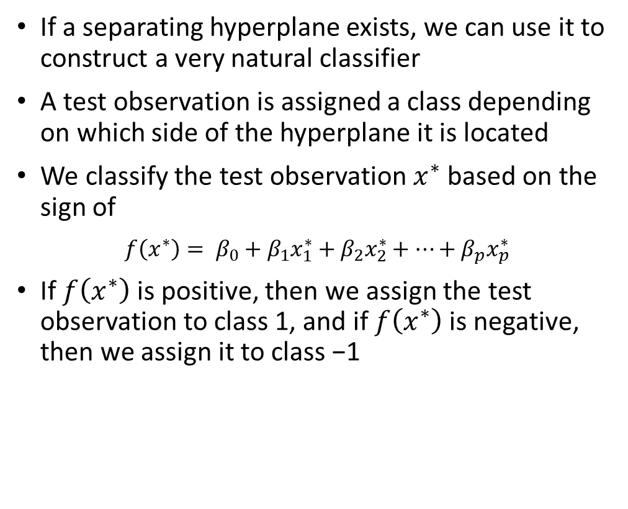
Maximal Margin Classifier
If a separating hyperplane exists, we can use it to construct a very natural classifier
A test observation is assigned a class depending on which side of the hyperplane it is located
We classify the test observation $x^{∗}$ based on the sign of
$f\left(x^{∗}\right)= β_{0}+β_{1}x_{1}^{∗}+β_{2}x_{2}^{∗}+…+β_{p}x_{p}^{∗}$
If $f\left(x^{∗}\right)$ is positive, then we assign the test observation to class 1, and if $f\left(x^{∗}\right)$ is negative, then we assign it to class −1
$$X_{2}$$
$$X_{1}$$

Slide 6
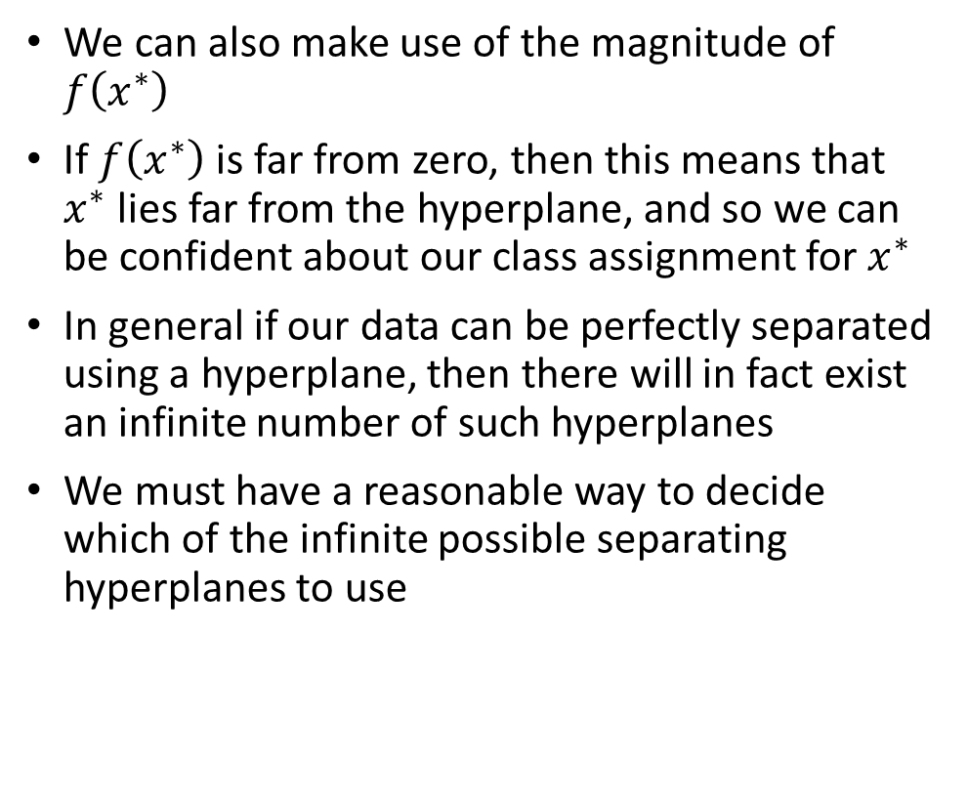
Maximal Margin Classifier
We can also make use of the magnitude of $f\left(x^{∗}\right)$
If $f\left(x^{∗}\right)$ is far from zero, then this means that $x^{∗}$ lies far from the hyperplane, and so we can be confident about our class assignment for $x^{∗}$
In general if our data can be perfectly separated using a hyperplane, then there will in fact exist an infinite number of such hyperplanes
We must have a reasonable way to decide which of the infinite possible separating hyperplanes to use
$$X_{2}$$
$$X_{1}$$

Slide 7
Maximal Margin Classifier
A natural choice is the maximal margin hyperplane (also known as the optimal separating hyperplane), which is the separating hyperplane that is farthest from the training observations
We can compute the (perpendicular) distance from each training observation to a given separating hyperplane
The smallest such distance is the minimal distance from the observations to the hyperplane, and is known as the margin
The maximal margin hyperplane is the separating hyperplane for which the margin is largest
$$X_{2}$$
$$X_{1}$$

Slide 8
Maximal Margin Classifier
We can then classify a test observation based on which side of the maximal margin hyperplane it lies
This is known as the maximal margin classifier
We hope that a classifier that has a large margin on the training data will also have a large margin on the test data, and hence will classify the test observations correctly
In a sense, the maximal margin hyperplane represents the mid-line of the widest “slab” that we can insert between the two classes
$$X_{2}$$
$$X_{1}$$

Slide 9
Maximal Margin Classifier
On the right, three training observations are equidistant from the maximal margin hyperplane
These points are called support vectors
They “support” the maximal margin hyperplane that if these points were moved slightly then the maximal margin hyperplane would move as well
A movement to any of the other observations would not affect the separating hyperplane
The fact that the maximal margin hyperplane depends directly on only a small subset of the observations is an important property that will be useful in building SVMs
$$X_{2}$$
$$X_{1}$$

Slide 10
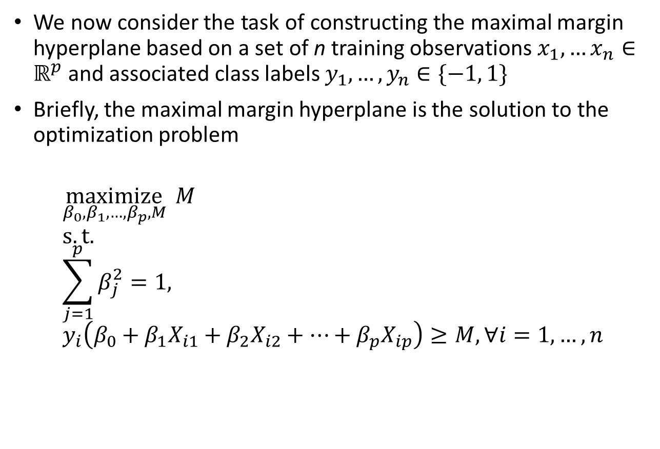
Construction of the Maximal Margin Classifier
We now consider the task of constructing the maximal margin hyperplane based on a set of n training observations $x_{1},…x_{n}∈ℝ^{p}$and associated class labels $y_{1},…, y_{n}∈\{−1, 1\}$
Briefly, the maximal margin hyperplane is the solution to the optimization problem
$$\underset{β_{0},β_{1},…,β_{p},M}{maximize}{ M} \\ s.t. \\ \sum_{j=1}^{p}{β_{j}^{2}=1,} \\ y_{i}\left(β_{0}+β_{1}X_{i1}+β_{2}X_{i2}+…+β_{p}X_{ip}\right)≥M, ∀i=1,…,n$$

Slide 11
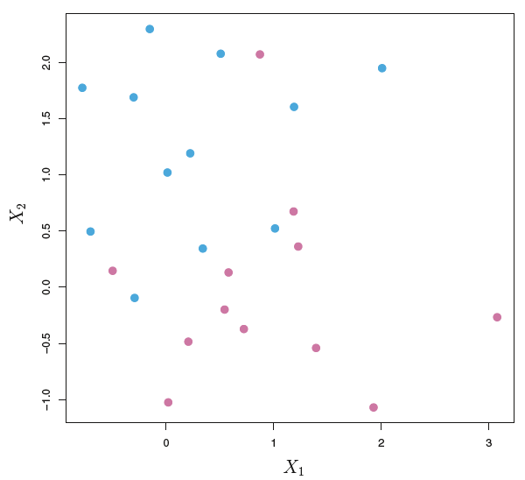
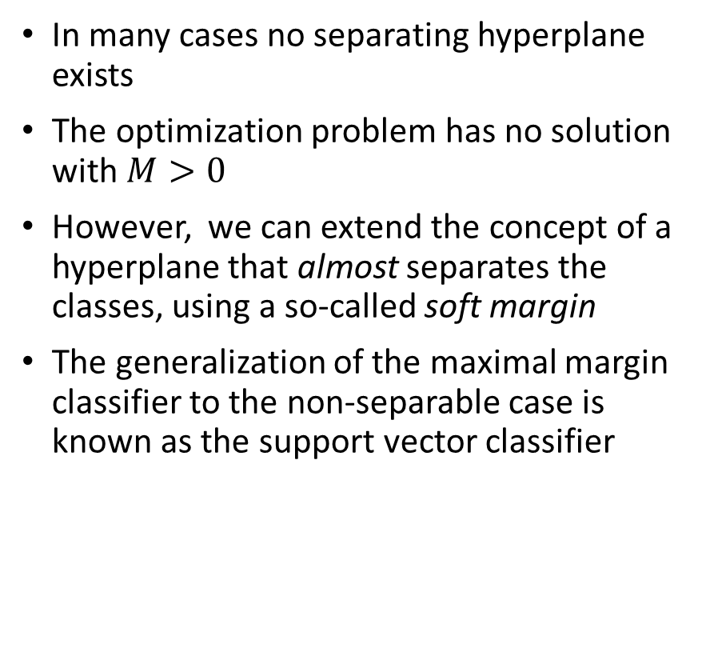
Non-Seperable Case
In many cases no separating hyperplane exists
The optimization problem has no solution with $M>0$
However, we can extend the concept of a hyperplane that almost separates the classes, using a so-called soft margin
The generalization of the maximal margin classifier to the non-separable case is known as the support vector classifier
M
M

Slide 12
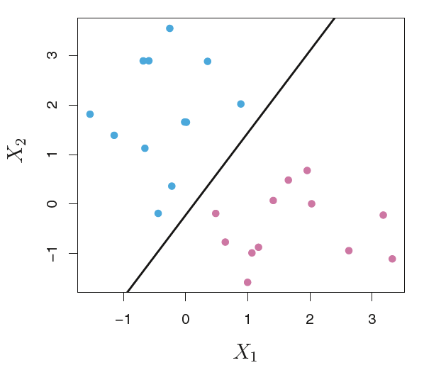
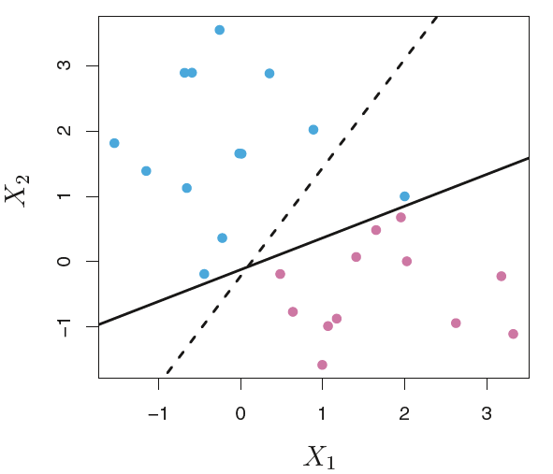
Support Vector Classifier
Even if a separating hyperplane does exist, it might not be desirable
The maximal margin hyperplane may be extremely sensitive to a change in a single observation
It may overfit the training data
Adding one point completeley changed the hyperplane

Slide 13
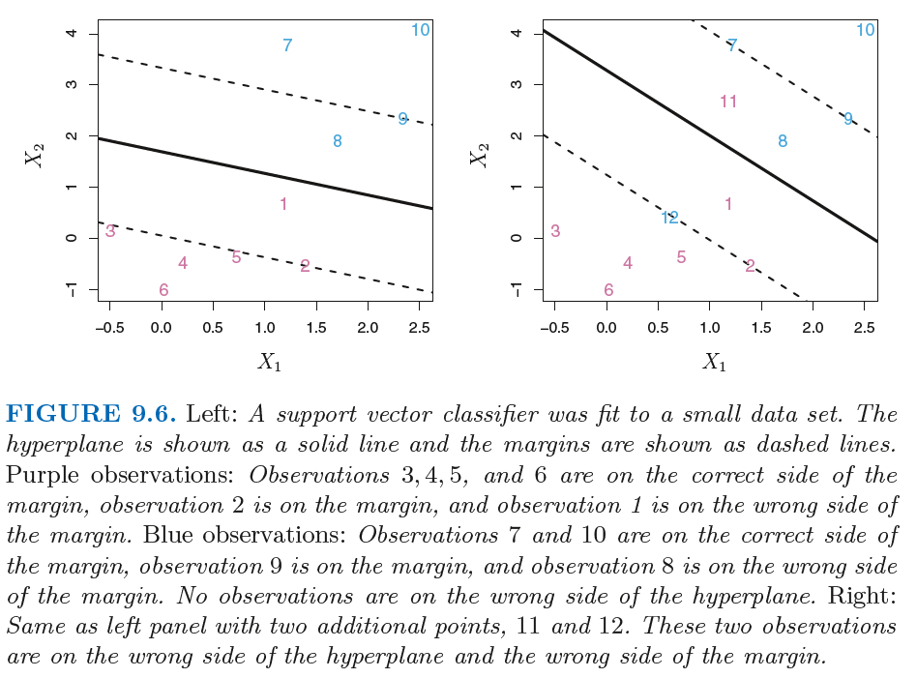
Support Vector Classifier
A hyperplane that does not perfectly separate the two classes
Greater robustness to individual observations
Better classification of most of the training observations
In other words, it could be worthwhile to misclassify a few training observations
The support vector classifier, sometimes called a soft margin classifier
We now allow some observations to be on the incorrect side of the margin, or even the incorrect side of the hyperplane

Slide 14
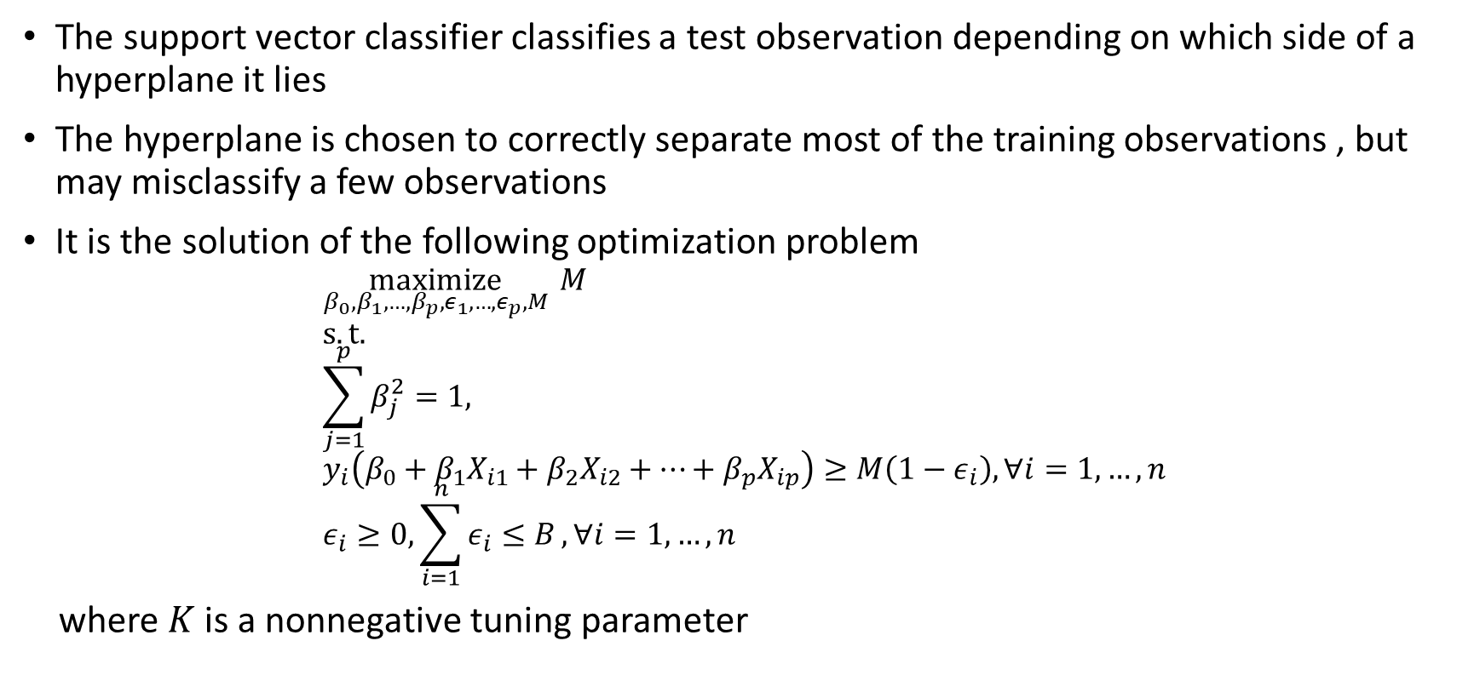
Support Vector Classifier
The support vector classifier classifies a test observation depending on which side of a hyperplane it lies
The hyperplane is chosen to correctly separate most of the training observations , but may misclassify a few observations
It is the solution of the following optimization problem
$$\underset{β_{0},β_{1},…,β_{p},ε_{1},…{,ε}_{p},M}{maximize}{ M} \\ s.t. \\ \sum_{j=1}^{p}{β_{j}^{2}=1,} \\ y_{i}\left(β_{0}+β_{1}X_{i1}+β_{2}X_{i2}+…+β_{p}X_{ip}\right)≥M\left(1−ε_{i}\right), ∀i=1,…,n \\ ε_{i}≥0, \sum_{i=1}^{n}{ε_{i}≤B},∀i=1,…,n$$
where $K$ is a nonnegative tuning parameter

Slide 15
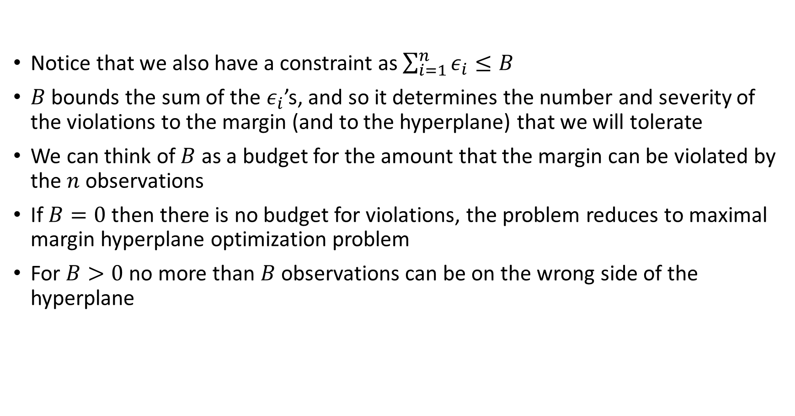
Support Vector Classifier
Notice that we also have a constraint as $\sum_{i=1}^{n}{ε_{i}}≤B$
$B$ bounds the sum of the $ε_{i}$’s, and so it determines the number and severity of the violations to the margin (and to the hyperplane) that we will tolerate
We can think of $B$ as a budget for the amount that the margin can be violated by the $n$ observations
If $B=0$then there is no budget for violations, the problem reduces to maximal margin hyperplane optimization problem
For $B>0$no more than $B$ observations can be on the wrong side of the hyperplane

Slide 16
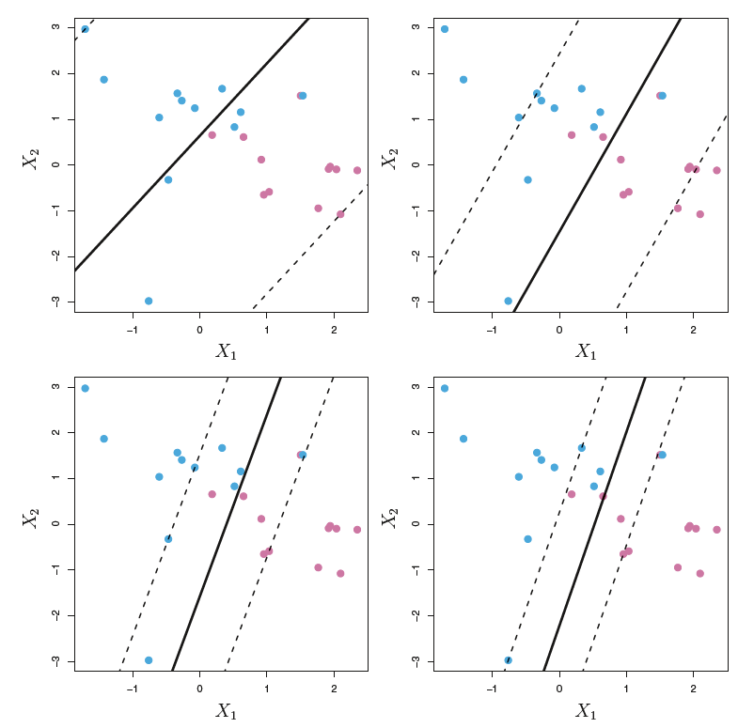
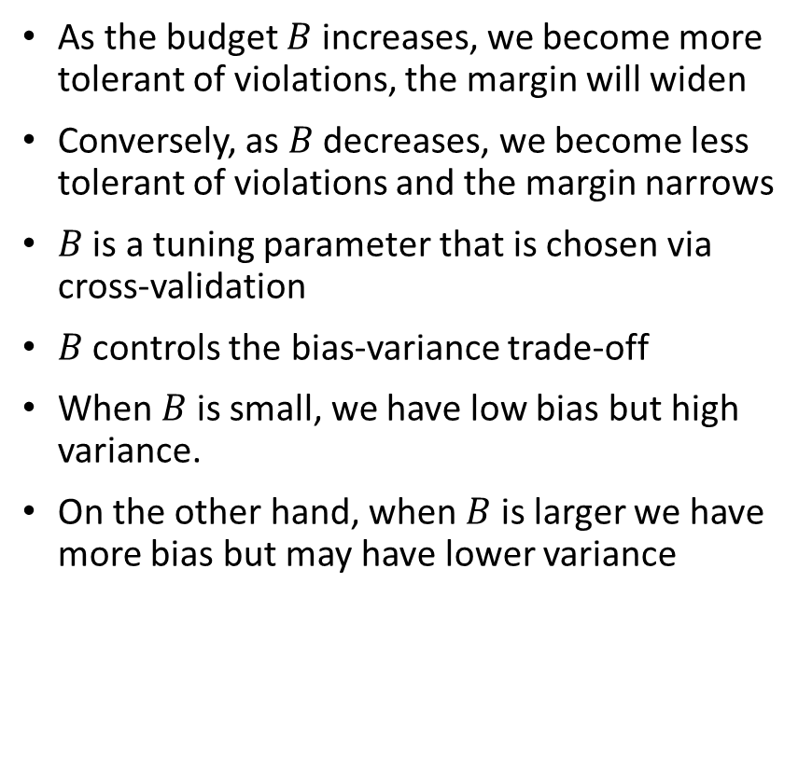
Support Vector Classifier
As the budget $B$ increases, we become more tolerant of violations, the margin will widen
Conversely, as $B$ decreases, we become less tolerant of violations and the margin narrows
$B$ is a tuning parameter that is chosen via cross-validation
$B$ controls the bias-variance trade-off
When $B$ is small, we have low bias but high variance.
On the other hand, when $B$ is larger we have more bias but may have lower variance

Slide 17
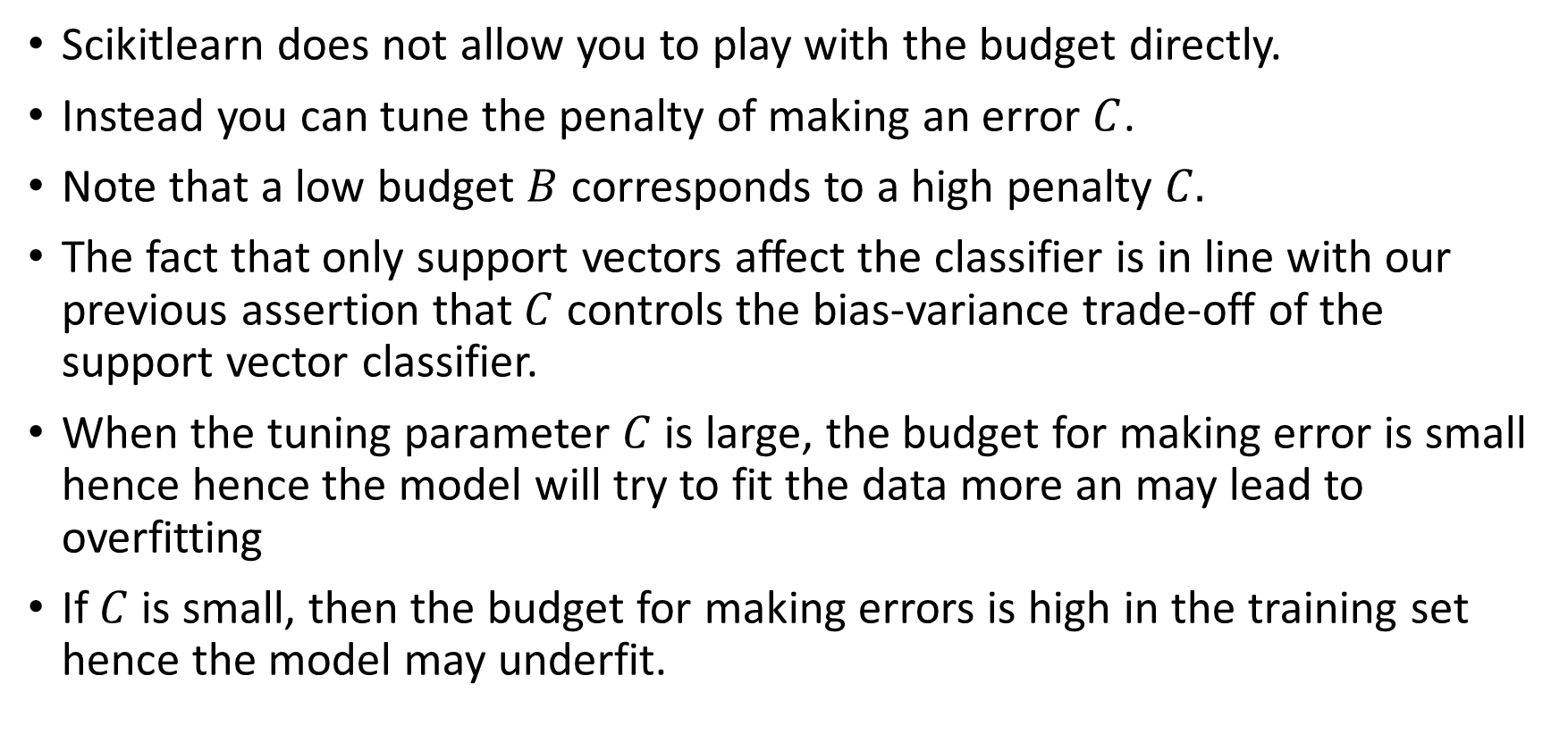
Support Vector Classifier
Scikitlearn does not allow you to play with the budget directly.
Instead you can tune the penalty of making an error $C$.
Note that a low budget $B$ corresponds to a high penalty $C.$
The fact that only support vectors affect the classifier is in line with our previous assertion that $C$ controls the bias-variance trade-off of the support vector classifier.
When the tuning parameter $C$ is large, the budget for making error is small hence hence the model will try to fit the data more an may lead to overfitting
If $C$ is small, then the budget for making errors is high in the training set hence the model may underfit.

Slide 18
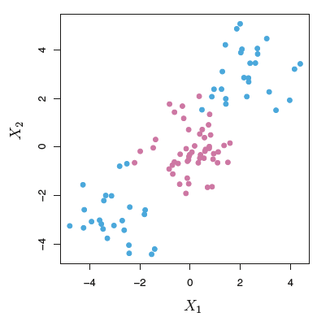
Non-Linear Decision Boundaries
It is clear that a support vector classifier or any linear classifier will perform poorly if the true decision boundary is non-linear
We could address the problem by enlarging the feature space using quadratic, cubic, and even higher-order polynomial functions of the predictors

Slide 19
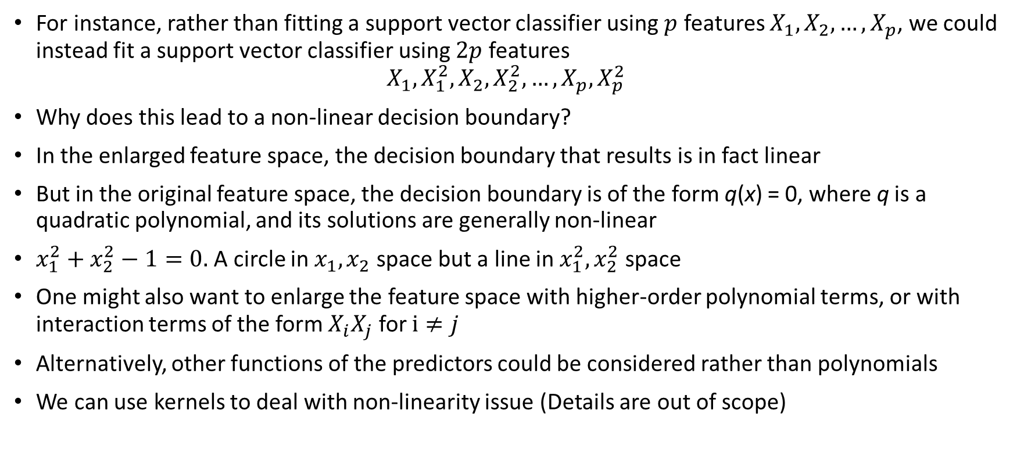
Non-Linear Decision Boundaries
For instance, rather than fitting a support vector classifier using $p$ features $X_{1},X_{2},…,X_{p}$, we could instead fit a support vector classifier using $2p$ features
$$X_{1},X_{1}^{2},X_{2},X_{2}^{2},…,X_{p},X_{p}^{2}$$
Why does this lead to a non-linear decision boundary?
In the enlarged feature space, the decision boundary that results is in fact linear
But in the original feature space, the decision boundary is of the form q(x) = 0, where q is a quadratic polynomial, and its solutions are generally non-linear
$x_{1}^{2}+x_{2}^{2}−1=0.$A circle in $x_{1},x_{2}$ space but a line in $x_{1}^{2},x_{2}^{2}$ space
One might also want to enlarge the feature space with higher-order polynomial terms, or with interaction terms of the form $X_{i}X_{j}$ for $i≠j$
Alternatively, other functions of the predictors could be considered rather than polynomials
We can use kernels to deal with non-linearity issue (Details are out of scope)

Slide 20
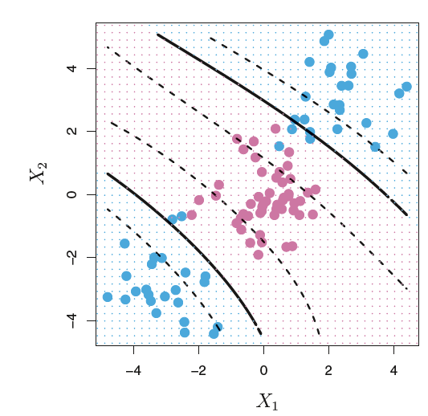
Support Vector Machines
An SVM with a polynomial kernel of degree 3 is applied to the non-linear data
The fit is a substantial improvement over the linear support vector classifier

Slide 21
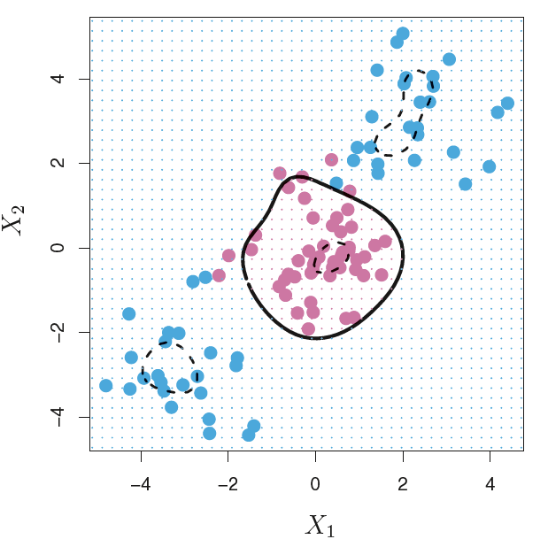
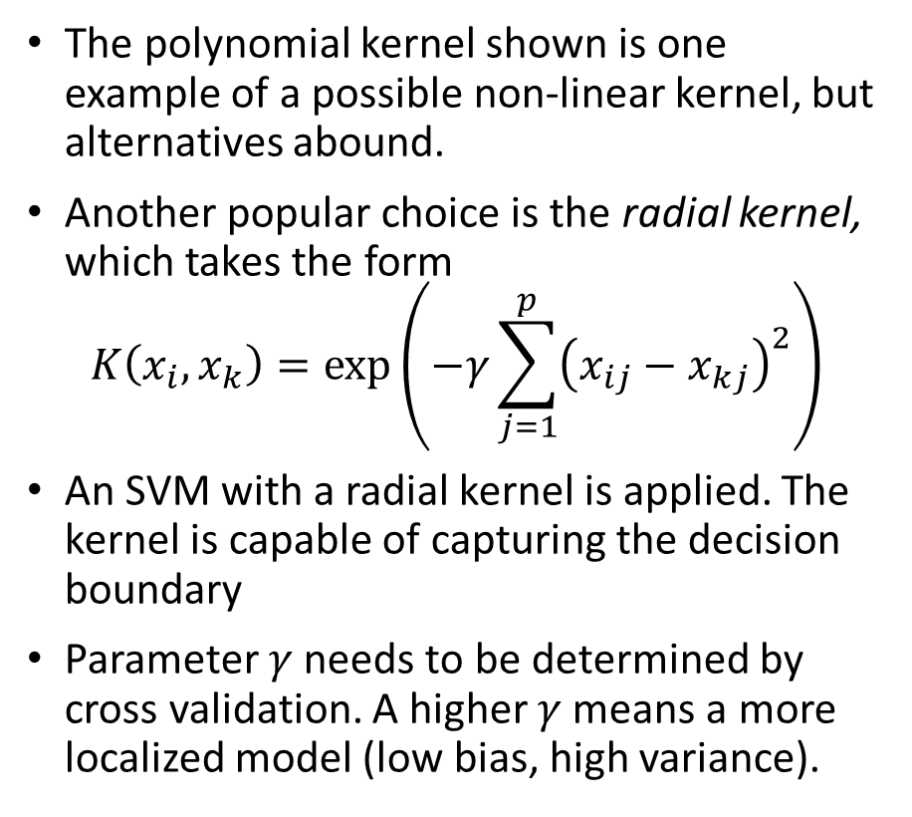
Support Vector Machines
The polynomial kernel shown is one example of a possible non-linear kernel, but alternatives abound.
Another popular choice is the radial kernel, which takes the form
$$K\left(x_{i},x_{k}\right)=\exp\left(−γ\sum_{j=1}^{p}{{\left(x_{ij}−x_{kj}\right)}^{2}}\right)$$
An SVM with a radial kernel is applied. The kernel is capable of capturing the decision boundary
Parameter $γ$ needs to be determined by cross validation. A higher $γ$ means a more localized model (low bias, high variance).

